Slide 1
A Context-Aware Approach to Android Memory Management
by
Srinivas Muthu

Slide 2
Before we get started..

Slide 3
Introduction

Slide 4
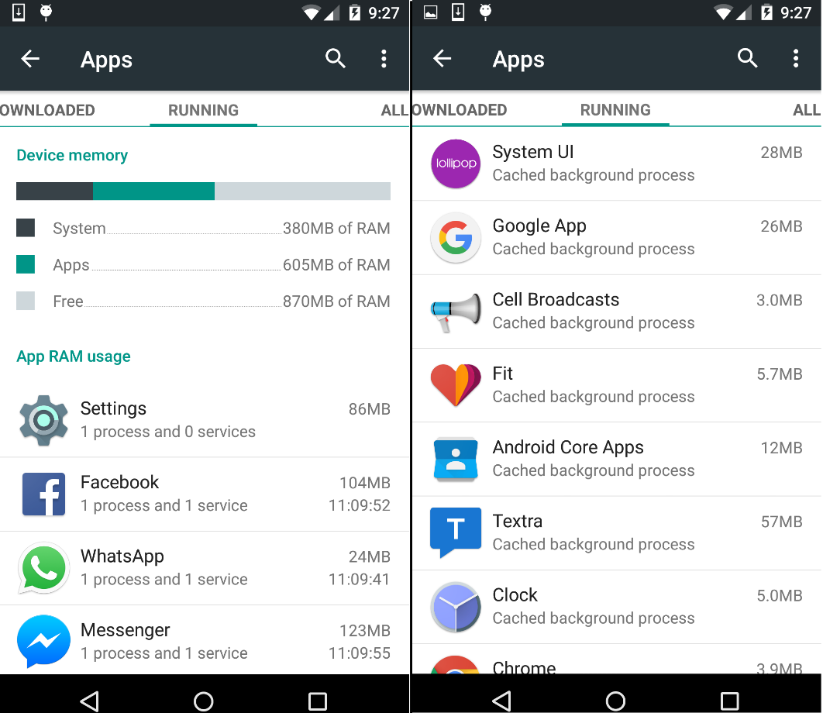
The Problem
Android built on top of Linux kernel
Every app runs in its own Linux process.
RAM contains active processes & CBP(s)
Displayed by Settings App
Lower startup time => Better UX
Determined by Recency of Usage
Better scheme?
Can context help?

Slide 5
Proposed Solution
Utilize context through Calendar
Predict apps likely to be used
3 possible caching schemes
Default (Recency)
Context (Calendar)
Default-Context Hybrid
Set up experiment (20 volunteers)
Compare efficiencies
Metrics?
How to get them?
Did context help?
Assumptions
Context through Calendar
Easy access (Android provides Public API)
Window into user’s potential future behavior
Android version in volunteer’s phone
API Level 21 (Lollipop 5.0) & above
Volunteers permit use of their calendar

Slide 6
Related Work

Slide 7
Early Studies in Context-Aware Computing
Dey, Salber & Abowd (2001)
A conceptual framework and a toolkit for supporting the rapid prototyping of context-aware applications
Defined Context
Humans, apps and surrounding environment
Inadequate research in Context Aware Applications
Context – Ill defined
Lack of conceptual models to jumpstart context-aware apps (back in ‘01)
Produced Context Toolkit
Framework to infer context from sensors
Modern day APMD(s) are perfect fit
Sensors measure 3D movement, positioning etc.
Suitable for utilizing context information

Slide 8
Context Phone
Mika Raento, Antti Oulasvirta, Renaud Petit, and Hannu Toivonen (2005)
ContextPhone: A Prototyping Platform for Context-Aware Mobile Applications
Mobile phones are suited for Context-Aware computing
Intimate user-phone relationship
Developed ContextPhone to provide context as a resource
4 components : Sensors, Communication Services, Customizable Applications and System Services
Necessity for customizable applications lead to Android
Android is open sourced (AOSP) => Highly customizable
Facilitates gathering relevant metrics
Not possible in iOS or other OS(s)

Slide 9
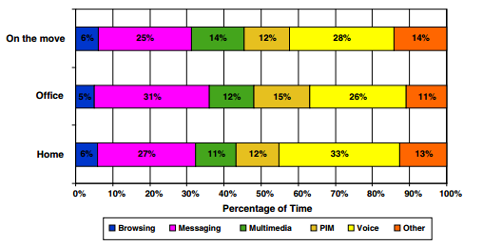
Context Patterns in Application Usage
Hannu Verkasalo (2007)
Contextual Patterns in Mobile Service Usage
Context influence service?
Context – Home, Office & On the move
Tracked user’s location patterns
Determined Context
Found Location : Service correlation
Preference for certain services in the weekends
Planted idea for inferring app usage from Context

Slide 10
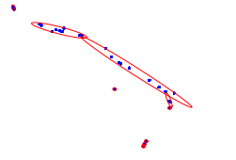
Alternate Ways to Utilize Context
Elaine Shi, Yuan Niu, Markus Jakobsson, and Richard Chow (2010)
Implicit Authentication through Learning User Behavior
Modelling user behavior
Calls/Day, Location traces
Implicit authentication
Good score vs bad score
High bad score => lock phone
Context :- utilized in various ways

Slide 11
Metrics of Interest

Slide 12

Cache Hits, Cache Misses & CHR
Cache Hit
User requests app already in memory
Either as active process or CBP
E.g. Messenger
Cache Miss
User requests app not in memory
Neither as active process nor CBP
E.g. Google Drive
Cache Hit Ratio
Ratio of hits to overall requests
CHR = (Hits / Hits + Misses)
Higher CHR => Lower startup time for more requests => Better UX

Slide 13
Caching Schemes Under Consideration

Slide 14
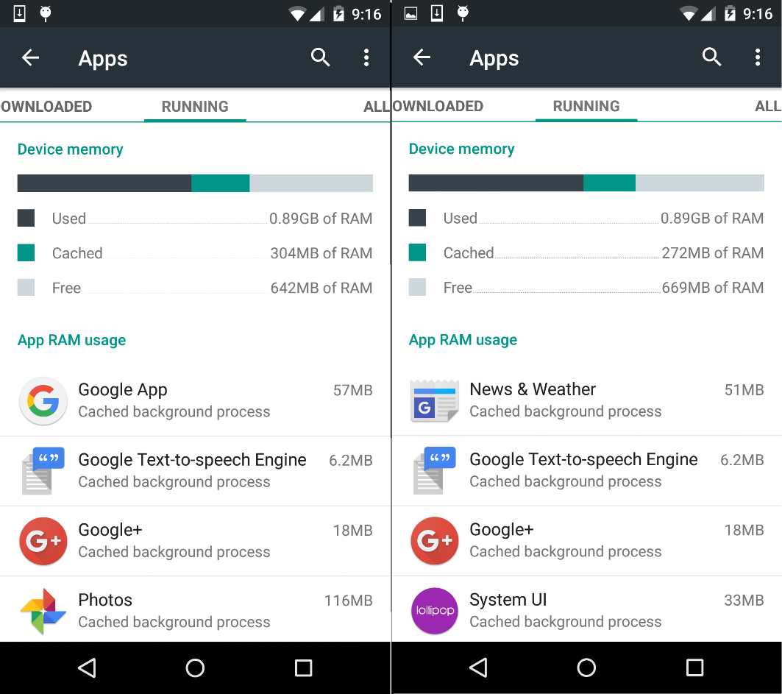
Default – Recency of Usage
Recency of application usage
CBP(s) have timestamps
Memory low => LRU CBP removed
Requesting an app not in memory
Cached as CBP after use
E.g. News & Weather app

Slide 15
Alternatives
Optimal
Always have requested app
Not Implementable in practice
Impossible to predict exact user behavior
Random
Randomly cache an app as CBP
Simplicity
No time-stamps or any meta info required
Used in ARM processors
No benefit in caching apps randomly
Frequency of Usage
MFU apps cached as CBP(s)
Potentially great fit
Smartphone user tendencies => Few apps with high frequency => Always cached in RAM
Our focus is Context Analysis
Revisit in future scope

Slide 16
Default-Context Hybrid
Previous schemes based on past behavior
Hybrid = Default + Context
Default : Recency of Usage
Context : Read Calendar -> Parse events -> Predict apps likely to be used
Combined list used for computing metrics
For Hybrid to work
Provision for Android to pro-actively cache apps
Prioritizing apps when memory is low

Slide 17
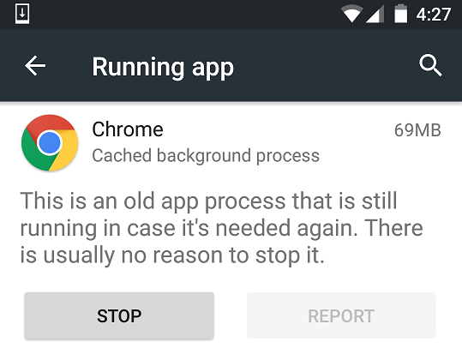
Pro-actively Caching Applications
Needed why?
What to do with list of apps predicted from context?
Provision for Android to pro-actively cache these as CBP(s)
Provision exists
Demonstrated through small experiment
Settings App -> Delete each CBP -> Idle phone for 3 minutes -> Settings App -> CBP list non-empty
Some from previous list, some brand new
Not just provision, it already does so

Slide 18
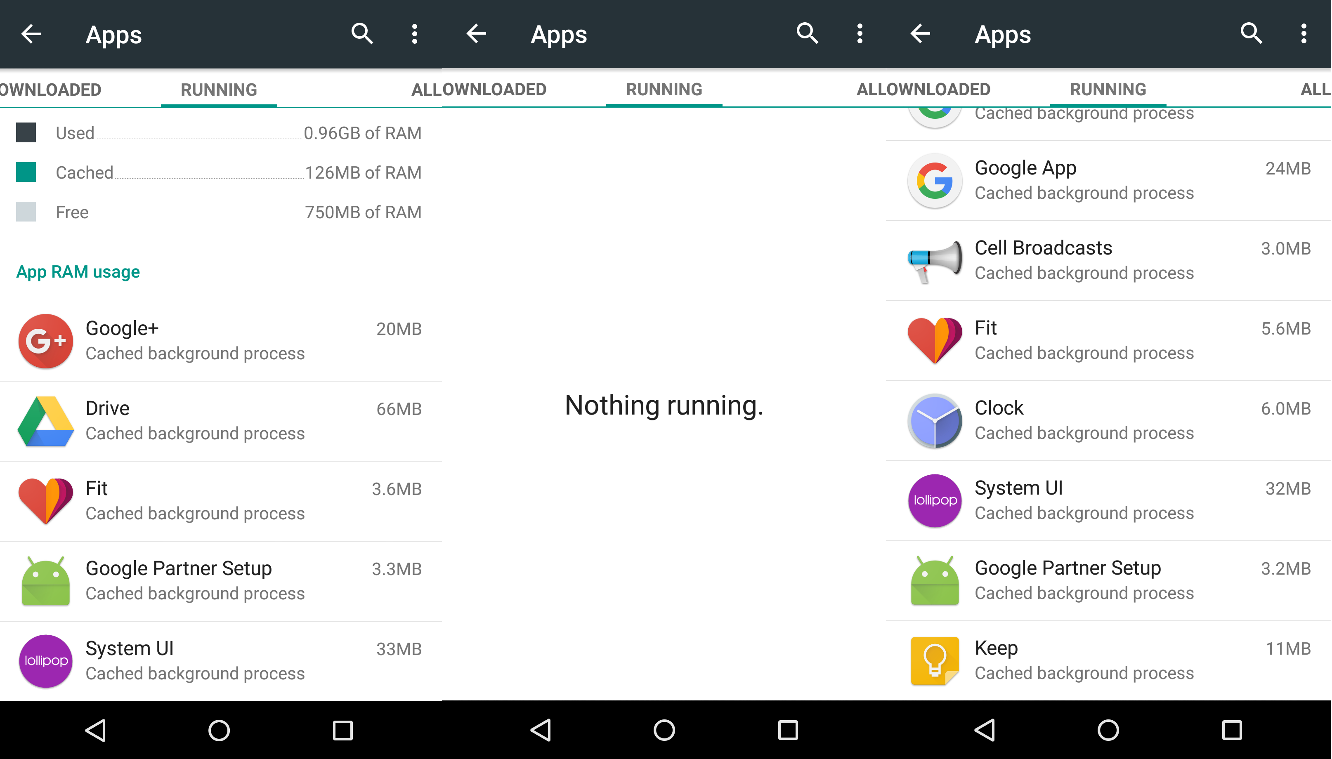

Slide 19
Prioritizing Applications in Hybrid Scheme
Hybrid scheme
Apps from default scheme (based on recency) → List 1
Apps inferred from Context (predicted from calendar) → List 2
Memory Low => Who has priority?
Recency cannot apply for overall list
Three Options
List 2 Priority > List 1 Priority
Context Inference implemented well
List 1 Priority > List 2 Priority
Context inference still in infancy
Memory heavy removed first
Releases memory quickly
Does not factor likelihood of usage

Slide 20
Supplementary Data
Fundamental metric → CHR
Measured for Default, Context & Default-Context Hybrid
Supplementary data → Check for correlations
#Installed Apps
#Unique Apps Clicked
#Calendar Entries
Gender, Age, Phone Model
Clues about usage patterns
Diversity in demographic
Android OS Version
For compatibility with experiment

Slide 21
Title and Content Layout with Chart

Slide 22
Two Content Layout with Table
First bullet point here
Second bullet point here
Third bullet point here
 | Group A | Group B
Class 1 | 82 | 95
Class 2 | 76 | 88
Class 3 | 84 | 90

Slide 23
Two Content Layout with SmartArt
Group A
Task 1
Task 2
Group B
Task 1
Task 2
Group C
Task 1
First bullet point here
Second bullet point here
Third bullet point here

